Slide 1
Chapter 4- Transmission impairments

Slide 2

Introduction
Signals travel through transmission media, which are not perfect.
The imperfection causes signal impairment.
This means that the signal at the beginning of the medium is not the same as the signal at the end of the medium.
What is sent is not what is received.
For analog signal, these impairments cause various modifications that degrade the signal quality.
For digital system, a binary 1 may be changed into a binary 0 and vice versa due to bit error.
Three causes of impairment are attenuation, distortion, and noise.

Slide 3
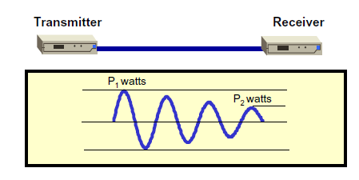
Attenuation
Attenuation means loss of energy.
When a signal, simple or complex, travels through a medium, it loses some of its energy so that it can overcome the resistance of the medium. That is why a wire carrying electrical signal gets warm. Some of the electrical energy in the signal is converted to heat.
To compensate for this loss, amplifiers are used to amplify the signal.

Slide 4
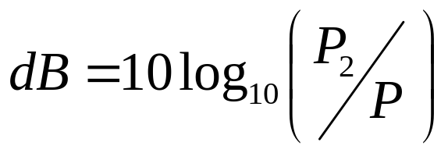
Decibel
Attenuation and amplification are measured in decibel (dB), which is expressed as a constant number of decibels per unit distance.
To show that a signal has lost or gained strength, engineers use the concept of the decibel. The decibel (dB) measures relative strengths of two signals or a signal at two different points.
The decibel is negative if a signal is attenuated and positive if a signal is amplified.
Where P₁ and P₂ are the powers of a signal points 1 and 2, respectively.

Slide 5

Decibel Cont.
Amplifiers or repeaters are inserted at intervals along the medium to improve the received signal as closed as its original level.

Slide 6

Example
Suppose a signal travels through a transmission medium and its power is reduced to one-half.
This means that P₂ is (1/2)P₁.
In this case, the attenuation (loss of power) can be calculated as
A loss of 3 dB (–3 dB) is equivalent to losing one-half the power.

Slide 7
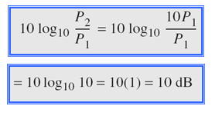
Example
A signal travels through an amplifier, and its power is increased 10 times. This means that P₂ = 10P₁. What is the amplification (gain of power)?

Slide 8
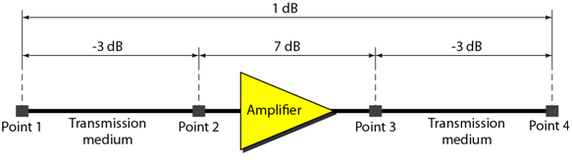

Example
One reason that engineers use the decibel to measure the changes in the strength of a signal is that decibel numbers can be added (or subtracted) when we are measuring several points (cascading) instead of just two.
A signal travels from point 1 to point 4.
In this case, the decibel value can be calculated as

Slide 9

Example
Sometimes the decibel is used to measure signal power in milliwatts. In this case, it is referred to as dB_{m} and is calculated as dB_{m} = 10 log10 P_{m} , where P_{m} is the power in milliwatts. Calculate the power of a signal with dB_{m} = −30.
Solution
We can calculate the power in the signal as

Slide 10
Distortion
Distortion means that the signal changes its form or shape.
Distortion can occur in a composite signal made of different frequencies.
Each signal component has its own propagation speed through a medium and, therefore, its own delay in arriving at the final destination.
Differences in delay may create a difference in phase if the delay is not exactly the same as the period duration. In other words, signal components at the receiver have phases different from what they had at the sender.
The shape of the composite signal is therefore not the same.

Slide 11

Distortion
Figure below shows the effect of distortion on a composite signal.

Slide 12
Noise
Noise is another cause of impairment. Several types of noise, such as thermal noise, induced noise, crosstalk, and impulse noise, may corrupt the signal.
Thermal noise is the random motion of electrons in a wire which creates an extra signal not originally sent by the transmitter.
Induced noise comes from sources such as motors and appliances. These devices act as a sending antenna, and the transmission medium acts as the receiving antenna.
Crosstalk is the effect of one wire on the other. A signal from one line is picked up by another.One wire acts as a sending antenna and the other as the receiving antenna.
Impulse noise is a spike (a signal with high energy in a very short time) that comes from power lines, lightning, and so on.
Noise is another cause of impairment. Several types of noise, such as thermal noise, induced noise, crosstalk, and impulse noise, may corrupt the signal.
Thermal noise is the random motion of electrons in a wire which creates an extra signal not originally sent by the transmitter.
Induced noise comes from sources such as motors and appliances. These devices act as a sending antenna, and the transmission medium acts as the receiving antenna.
Crosstalk is the effect of one wire on the other. One wire acts as a sending antenna and the other as the receiving antenna.
Impulse noise is a spike (a signal with high energy in a very short time) that comes from power lines, lightning, and so on. Figure below shows the effect of noise on a signal.

Slide 13

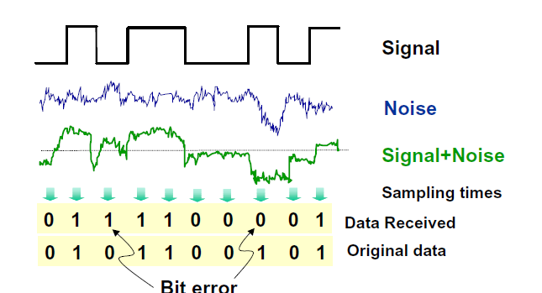
Noise

Slide 14
Problem
Briefly Explain the causes of transmission impairment.

Slide 15
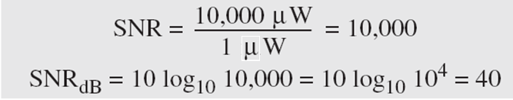
Signal to Noise Ratio (SNR)
To measure the quality of a system the SNR is often used. It indicates the strength of the signal with respect to the noise power in the system.
It is the ratio between two powers.
It is usually given in dB and referred to as SNR_{dB.}
Example
The power of a signal is 10 mW and the power of the noise is 1 μW; what are the values of SNR and SNR_{dB?}
Solution

Slide 16
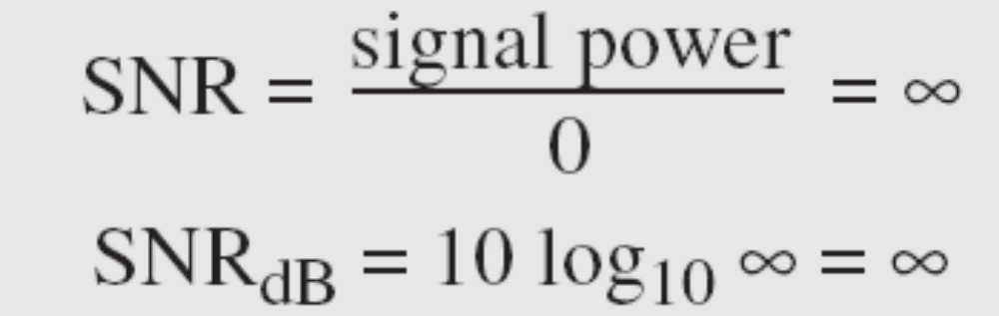
Signal to Noise Ratio (SNR)
The values of SNR and SNR_{dB} for a noiseless channel are
We can never achieve this ratio in real life; it is an ideal case.

Slide 17

Two cases of SNR: a high SNR and a low SNR

